Slide 1
MENTAL HEALTH GAME
LIMITLESS POWER
Team No: TECH016 PANIMALAR ENGINEERING COLLEGE

Slide 2
Team members Name | Mail id | Team faculty Mentor | Mail id
KAVYA SRI N | kavyasri.nlr2003@gmail.com | JENNIFER D | jenniferg.cse@gmail.com
KALPANA DEVI M | kalpusupreet@gmail.com | JENNIFER D | jenniferg.cse@gmail.com
SRINITHI A | srinithiannamalai2472004@gmail.com | JENNIFER D | jenniferg.cse@gmail.com
AJITHA M | ajithamuthuraj09@gmail.com | JENNIFER D | jenniferg.cse@gmail.com
Team details:
Team Name – LIMITLESS POWER Team No – TECH016 College Name – PANIMALAR ENGINEERING COLLEGE

Slide 3

PROBLEM STATEMENT DETAILING
MENTAL HEALTH GAME
A mobile or web game that focuses on improving Mental Health through mindfulness and relaxation techniques. This can be integrated with the YouTube videos for the various types of exercise. NHS API can be used.
Our goal is to relieve stress and anxiety, stimulate the brain and mental process, combat loneliness and assist with challenges with other people.

Slide 4
Cope with the stresses of life
Be physically healthy
Have good relationship
Work productively
Realize your full potential

Slide 5
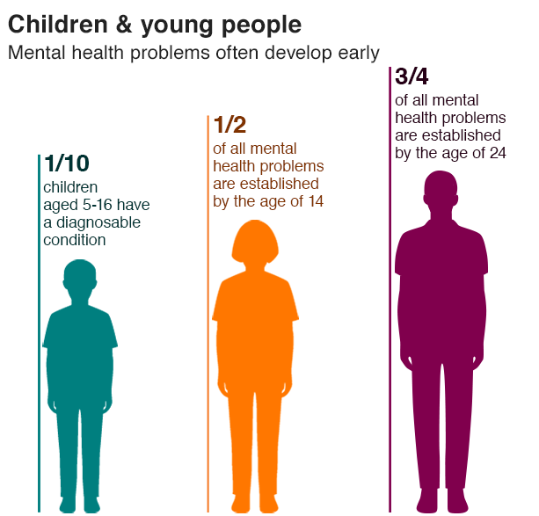

Slide 6


SOLUTION

Slide 7
METRICS IMPACT
User engagement
Mood improvement
Tracking of mental health goals

Slide 8
TECHNOLOGY STACK
Frontend: HTML5, CSS, JavaScript ( for interactive UI)
Backend: Node.js, Python (for game logic, user management, and data storage)
Database: MongoDB (for storing user data and game progress)
Cloud Services: Azure for hosting, scalability, and AI/ML services.
AI/ML Frameworks: TensorFlow for mood analysis and personalized interventions.
Analytics: Google Analytics for tracking user engagement and behaviour.

Slide 9
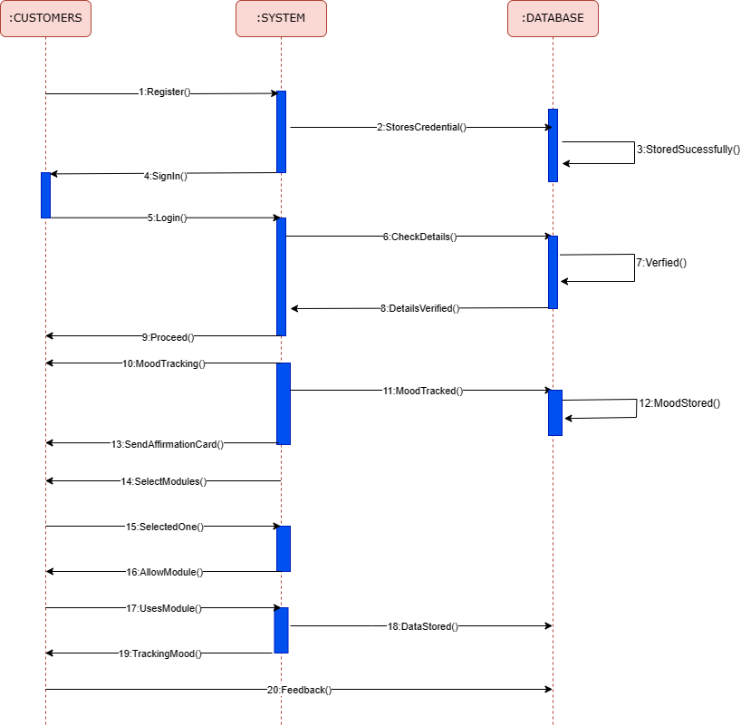
HIGH-LEVEL DESIGN

Slide 10
DEPENDENCIES
User Data Storage: You might rely on external databases (e.g., AWS RDS) to store user data securely.
AI/ML Services: If using AI/ML for mood analysis, you'll depend on these services, which could be cloud-based.
Content Delivery Network (CDN): For serving multimedia content, a CDN like AWS CloudFront might be used.
Payment Processing: If the game has a premium version, you'd need integration with payment gateways like Stripe.

Slide 11
LIMITATIONS
Ethical Considerations: Mental health is a sensitive topic. The game should be designed with ethical guidelines in mind, avoiding potential harm.
Privacy and Data Security: Handling user data, especially mental health-related data, requires strict privacy and security measures.
Effectiveness: The effectiveness of the game in improving mental health can vary widely among users.
Technical Challenges: Implementing AI/ML for mood analysis can be complex and may require continuous refinement.
User Engagement: Ensuring long-term engagement can be challenging. Frequent updates and novel content may be required.
Regulatory Compliance: Depending on your region, there might be regulatory requirements for mental health applications.

Slide 12
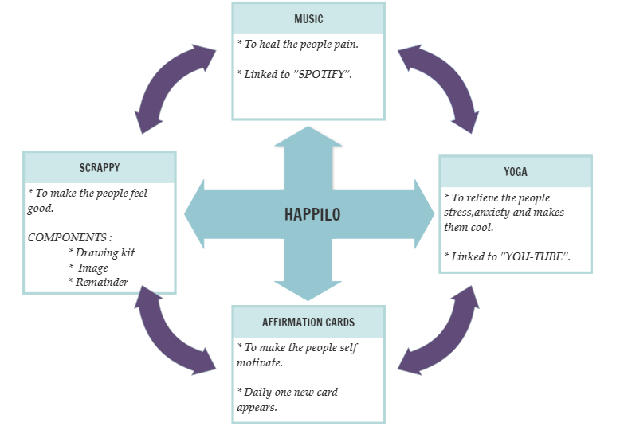
MODULES

Slide 13
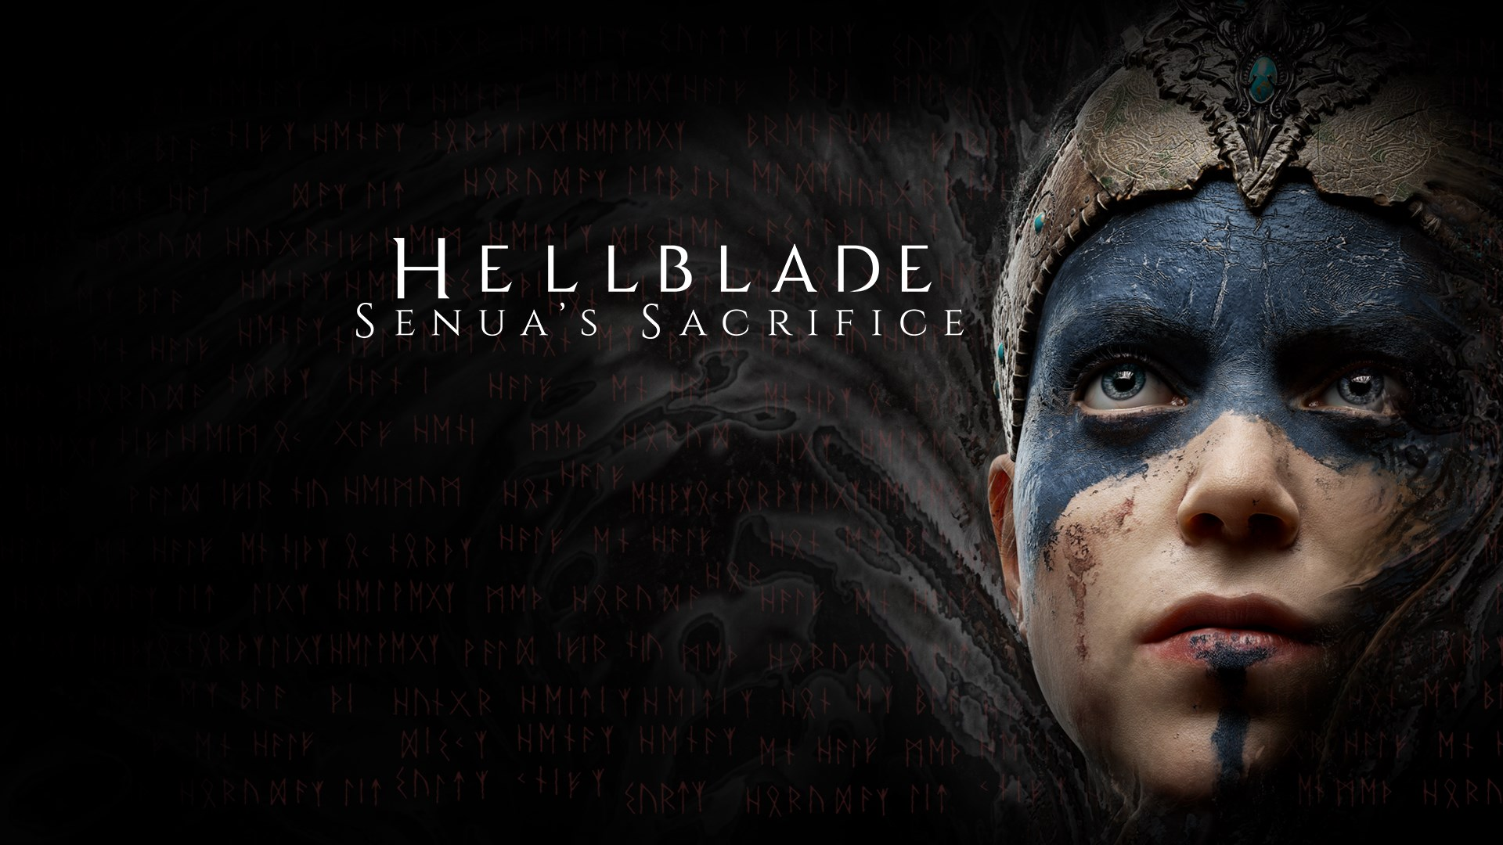
MAIN MODULE – GAME USING API
A game API is a software interface that allows developers to create and enhance game applications and access data, statistics, and features from other games or game servers.
A game API is an intermediate between a user’s OS and game databases.
Hellblade: Senua's Sacrifice on Steam (steampowered.com)
Like this adventurous game,
we are going to connect using API.

Slide 14
SOURCE CODE
https://github.com/kalpanadevi2003/MHG.html
Not yet created fully!
We will complete it soon!

Slide 15

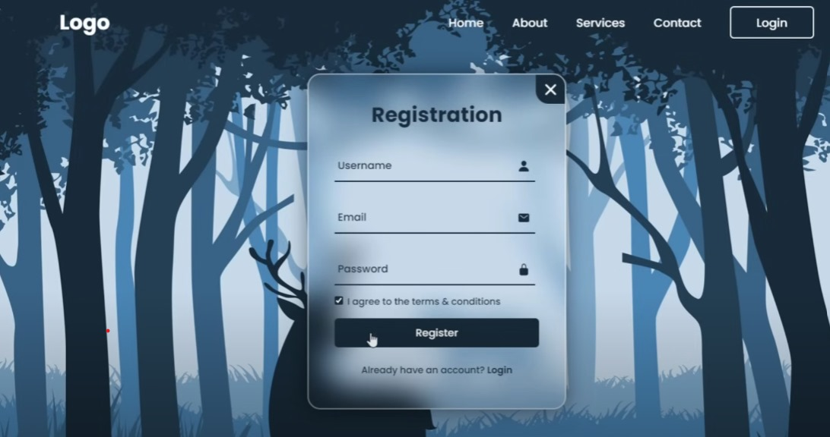
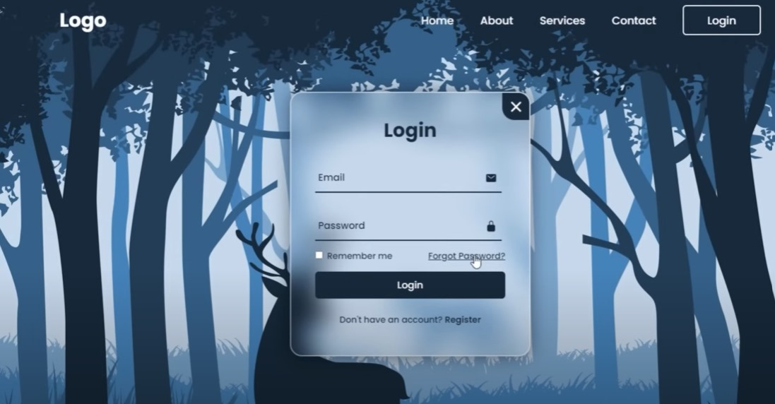
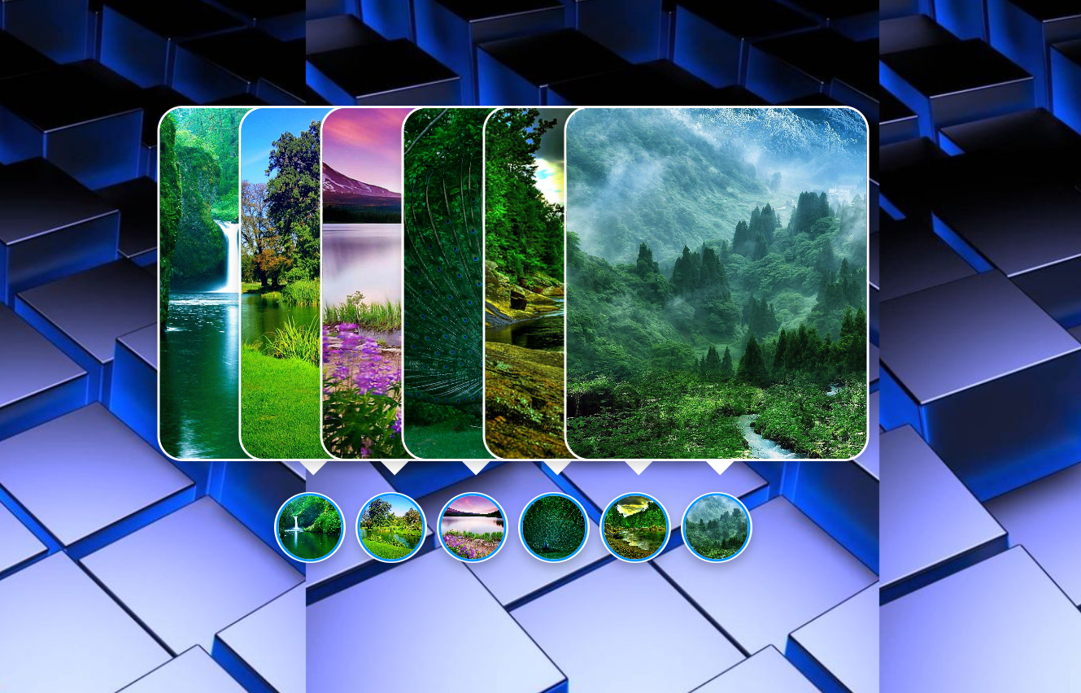
SAMPLE USER INTERFACE

Slide 16
MENTOR CONNECT DETAILS
Date of connect | Time | Details on the development | Agenda of the meet
12-09-2023 | 12:40-3:00 | Created Frontend and a clear idea to pursue our project. | Mini Project periods, weekly once for 3 hours.

Slide 17

DESCRIPTION: * Using ML, the Moods of the Customer are identified. * Affirmation Card is automatically generated according to the user’s mood to Self-motivate them. * Users can select modules, use them and save them. * Each module has features that can be useful and motivate the users. * Again users’ moods can be tracked to know how they feel after they use our app “HAPPILO”. * Finally, users will rate our app. LOGO OF OUR APP

Slide 18
THANK YOU!
Never give up on someone with mental illness.
When “I” is replaced by “We”, it becomes “WELLNESS”!

